Slide 1
WEEK 2

Slide 2
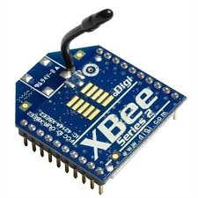
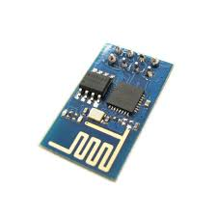
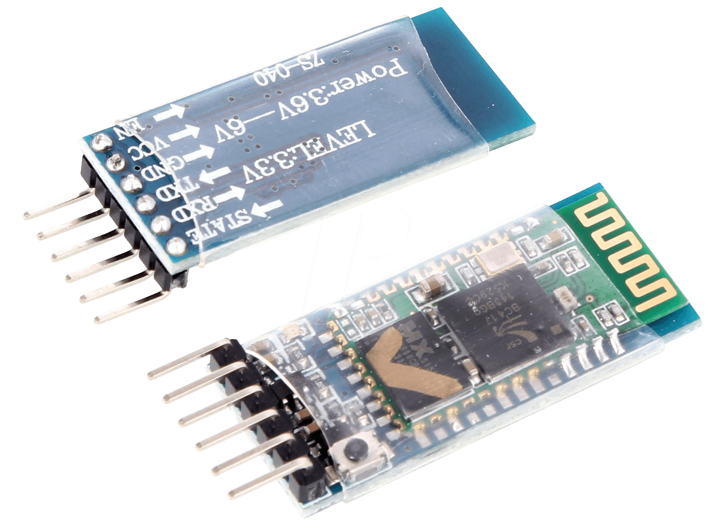
Connectivity/Communication
BLUETOOTH MODULE
WIFI MODULE

Slide 3
UART AND SERIAL OBJECT IN ARDUINO
UART is like a harbour, that takes care of all the data movement.
PIN 0 and 1 of arduino uno are receiver(RX) and transmitter(TX) pin respectively
The Serial thingy in the arduino, has an attribute available().
syntax - Serial.available(). This can be used to check whether something is received or not.
caution - when programming the uno, make sure nothing is connected to the pin 0 and 1.

Slide 4
BAUD RATE
BAUD RATE IS THE SPEED AT WHICH, COMMUNICATION OCCURS.
IN ORDER FOR A COMMUNICATION TO TAKE PLACE PROPERLY, YOU MUST MAKE SURE THAT THE SPEED OF RECECPTION EQUALS THE SPEED OF TRANSMISSION.

Slide 5
Python Serial Library
Pyserial is a python implementation of accessing the serial port of your PC.
This can be used to send and receive data from your PC.
Link to pyserial - here

Slide 6
EXAMPLE PYSERIAL CODE
serial.Serial() as ser:
ser.baudrate = 19200
ser.port = 'COM1'
ser.open()
ser.write(b'hello')
ser.close()

Slide 7
TASK
To make a PC connected(wired) robot, that responds to commands sent from the python code.
References - here (be selective and filter only what you want)

